Slide 1
Chapter 12: Analog-to-Digital Converter
The PIC18 Microcontroller
Han-Way Huang
Minnesota State University, Mankato
June 2004
Copyright @ 2005 Delmar Thompson

Slide 2
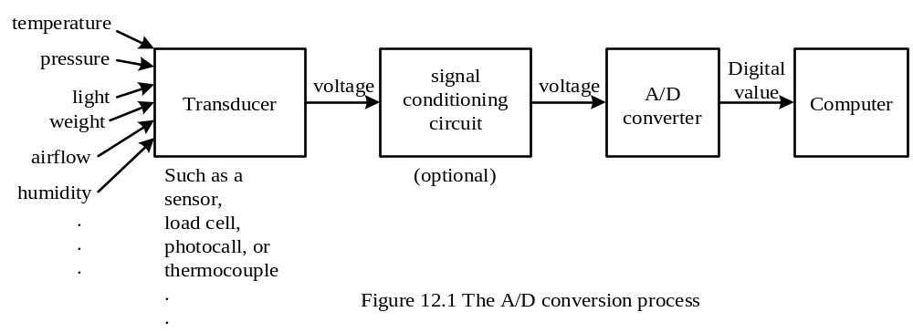
Basics of A/D Conversion
Can convert only electrical voltages to digital values
A transducer is needed to convert a non-electric quantity into an electrical voltage
Different names of transducers are used for different physical quantities
A data acquisition system is used to referred to those systems that perform A/D conversions.
Copyright @ 2005 Delmar Thompson

Slide 3
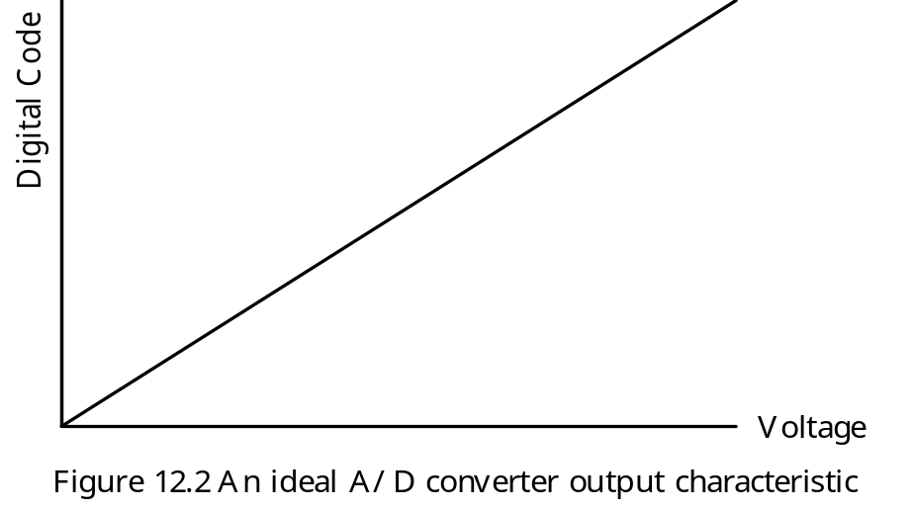
Analog Voltage and Digital Code Characteristic
1. Characteristic of an Ideal A/D Converter
- Needs infinite number of bits to encode the A/D conversion result
- Unachievable and impractical
Copyright @ 2005 Delmar Thompson

Slide 4
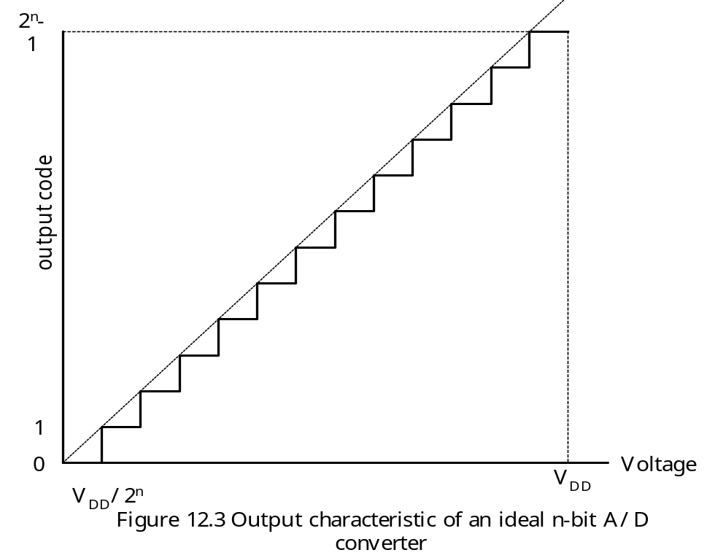
Characteristic of an Ideal n-bit A/D Converter
The area between dotted line and staircase is called the quantization error.
The resolution of this A/D converter is V_{DD}/2^{n}.
Average conversion error is V_{DD}/2^{n+1}.
A real A/D converter has nonlinearity.
Copyright @ 2005 Delmar Thompson

Slide 5
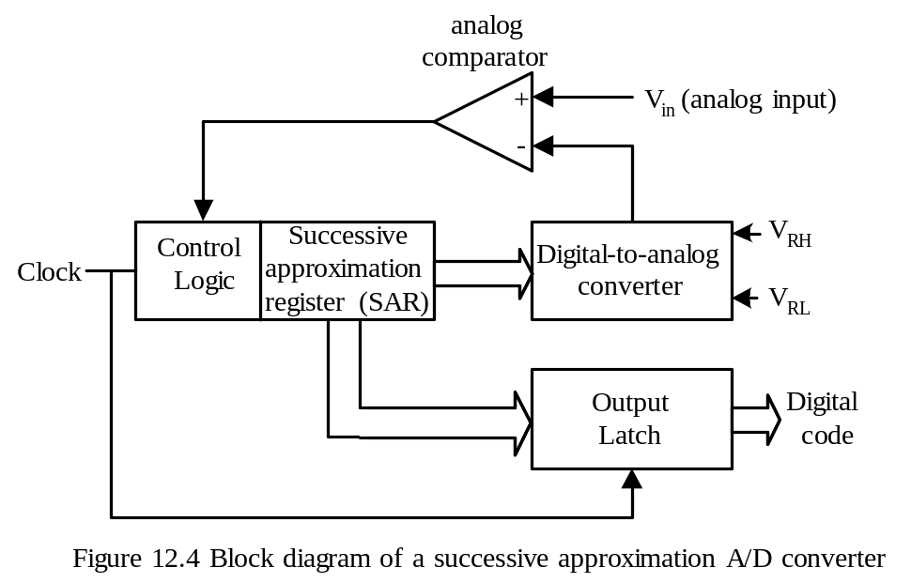
A/D Conversion Algorithms
Parallel (Flash) A/D converter
Slope and double-slope A/D converter
Sigma-Delta A/D converter
Successive Approximation A/D converter
Successive Approximation A/D Conversion Method
- Most commonly used A/D conversion method for 8-bit and 16-bit microcontrollers.
Copyright @ 2005 Delmar Thompson

Slide 6
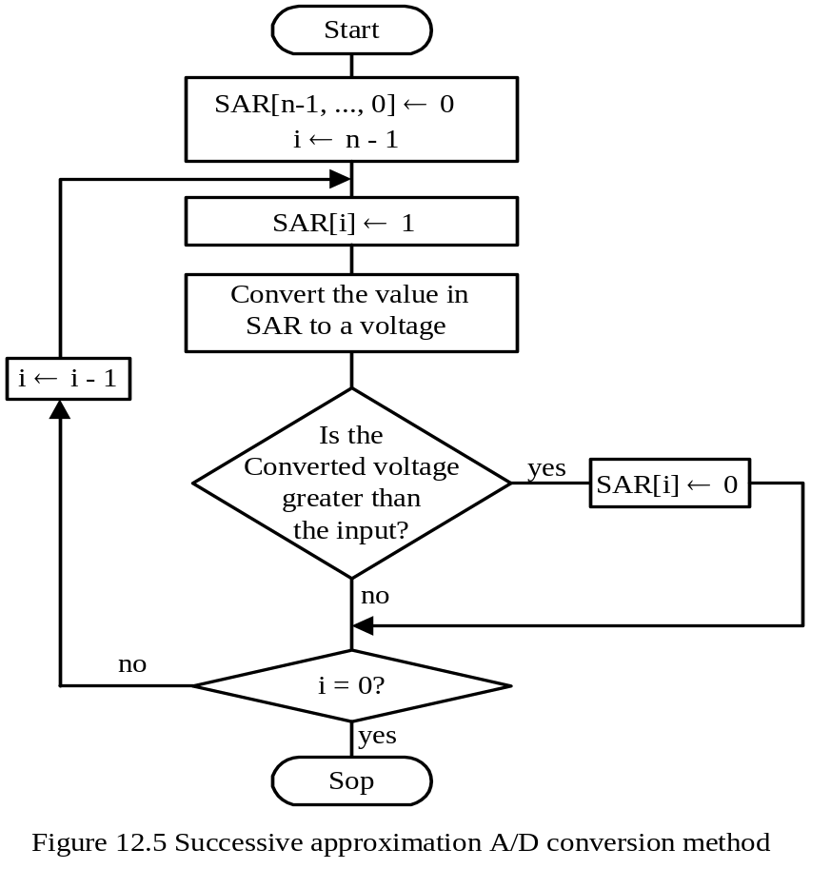
Successive Approximation Method
Copyright @ 2005 Delmar Thompson

Slide 7
Optimal Voltage Range for A/D Conversion
A/D converter requires a low reference voltage (V_{REF-}) and a high reference voltage (V_{REF+}) to perform conversion.
Most A/D converters are ratiomertic:
1. An analog input of V_{REF-} is converted to digital code 0.
2. An analog input of V_{REF+} is converted to digital code 2^{n} – 1.
3. An analog input of k V is converted to digital code
(2^{n} – 1) × (k - V_{REF-}) ÷ (V_{REF+} - V_{REF-})
- The A/D conversion result k corresponds to the following analog input:
V_{K} = V_{REF-} + (V_{REF+} - V_{REF-}) × k ÷ (2^{n} – 1)
Most systems use V_{DD} and 0V as V_{REF+} and V_{REF-}, respectively.
The output of a transducer should be scaled and shifted to the range of 0V ~ V_{DD} in order to achieve the best accuracy
Copyright @ 2005 Delmar Thompson

Slide 8
Example 12.1 Suppose that there is a 10-bit A/D converter with V_{REF-} = 1 V and V_{REF+} = 4V. Find the corresponding voltage values for the A/D conversion results of 25, 80, 240, 500, 720, 800, and 900.
Solution:
The corresponding voltages are as follows:
1V + (3 × 25) ÷ (210 – 1) = 1.07 V
1V + (3 × 80) ÷ (210 – 1) = 1.23 V
1V + (3 × 240) ÷ (210 – 1) = 1.70 V
1V + (3 × 500) ÷ (210 – 1) = 2.47 V
1V + (3 × 720) ÷ (210 – 1) = 3.11 V
1V + (3 × 800) ÷ (210 – 1) = 3.35 V
1V + (3 × 900) ÷ (210 – 1) = 3.64 V
Copyright @ 2005 Delmar Thompson

Slide 9
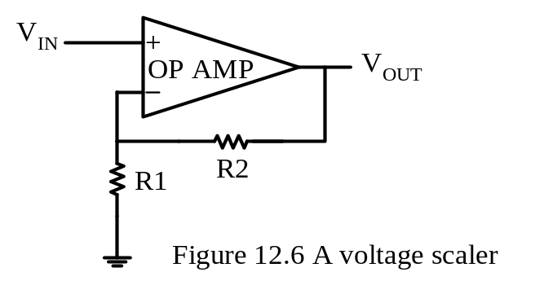
Scaling Circuit
Used to amplify the transducer output from a range of 0V ~ V_{Z} to 0 ~ V_{DD}.
Usually V_{Z} is smaller than V_{DD}.
Voltage gain of the circuit in Figure 12.6 is
A_{V} = V_{OUT} ÷ V_{IN} = (R₁ + R₂) ÷ R₁ = 1 + R₂/R₁ (12.2)
- Both R₁ and R₂ must be commercially available resistors.
Copyright @ 2005 Delmar Thompson

Slide 10
Scaling Circuit
A_{V} = V_{OUT} ÷ V_{IN} = (R₁ + R₂) ÷ R₁ = 1 + R₂/R₁
Example 12.2 Suppose the transducer output voltage ranges from 0V to 200 mV. Choose the appropriate values for R1 and R2 to scale this range to 0~5V.
Solution:
R2/R1 = (V_{OUT} /V_{IN}) – 1 = 24
Choose 240 KΩ for R₂ and 10 KΩ for R₁.
Copyright @ 2005 Delmar Thompson

Slide 11
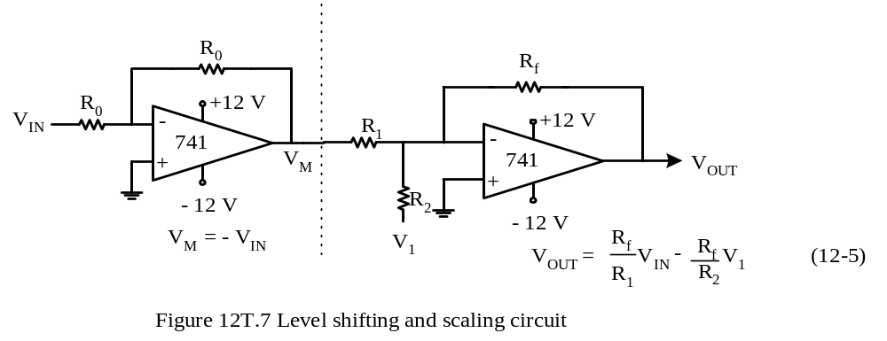
Summing circuit (Fig 12.7-a of the textbook)
V_{IN}
Copyright @ 2005 Delmar Thompson

Slide 12

Inverting voltage follower circuit (Fig 12.7-b of the textbook)
Copyright @ 2005 Delmar Thompson

Slide 13

Voltage Translation Circuit
Needed to shift and scale the transducer output in a range of –V_{X} ~ V_{Z} to 0V ~ V_{DD}.
Copyright @ 2005 Delmar Thompson

Slide 14

Example 12.3 Choose appropriate resistor values and the adjusting voltage so that the circuit shown in Figure 12.7c can shift the voltage from the range of –1.2V ~ 3.0V to the range of 0V ~ 5V.
Solution: Applying Equation 12.5:
0 = -1.2 × (Rf/R1) – (Rf/R2) × V1
5 = 3.0 × (Rf/R1) – (Rf/R2) × V1
Choose R0 = R1 = 10 KΩ and V₁ = -5V, solve R₂ = 50 KΩ, and R_{f} = 12KΩ
Copyright @ 2005 Delmar Thompson

Slide 15
The PIC18 A/D Converter
The PIC18 has a 10-bit A/D converter.
The number of analog inputs varies among difference PIC18 devices.
The A/D converter has the following registers:
A/D Result High Register (ADRESH)
A/D Result Low Register (ADRESL)
A/D Control Register 0 (ADCON0)
A/D Control Register 1 (ADCON1)
A/D Control Register 2 (ADCON2)
- The contents of these registers vary with the PIC18 members.
- Early PIC18 (PIC18FXX2) members have only ADCON0 and ADCON1 registers.
Copyright @ 2005 Delmar Thompson

Slide 16
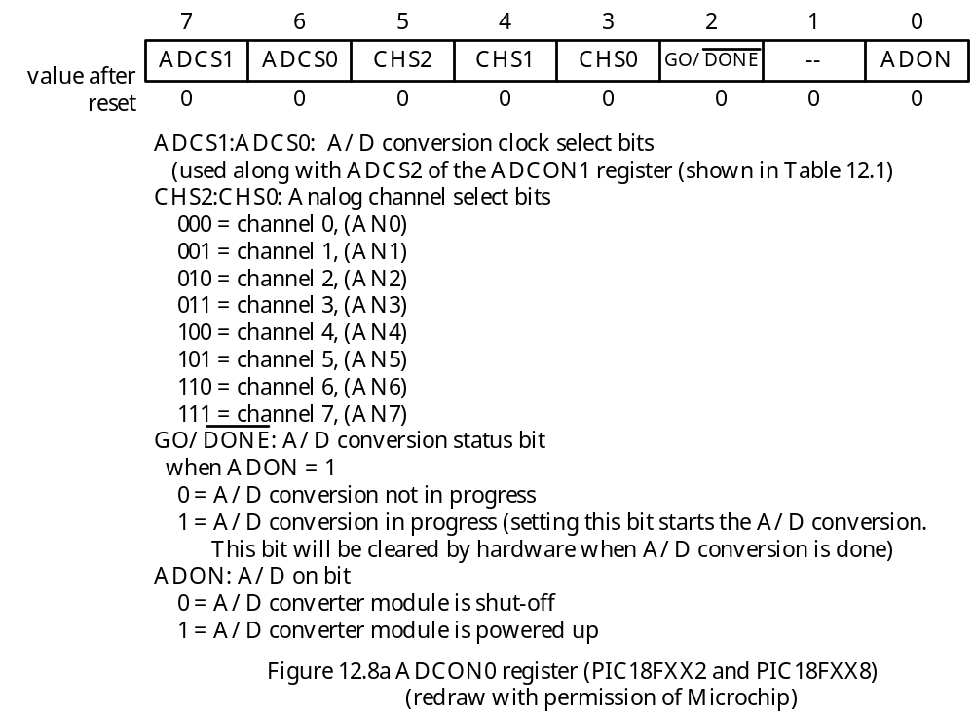
ADCON0 Register
Copyright @ 2005 Delmar Thompson

Slide 17
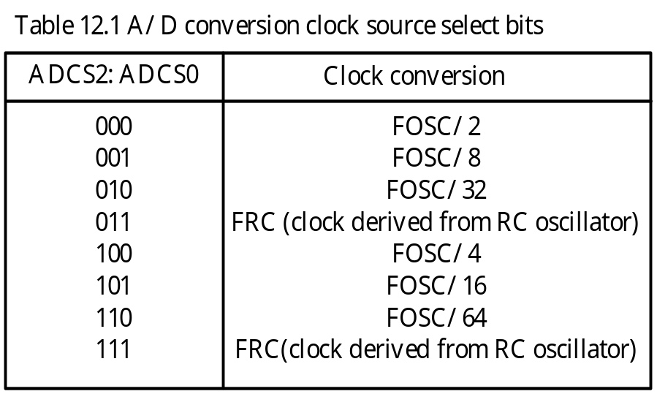
Copyright @ 2005 Delmar Thompson

Slide 18
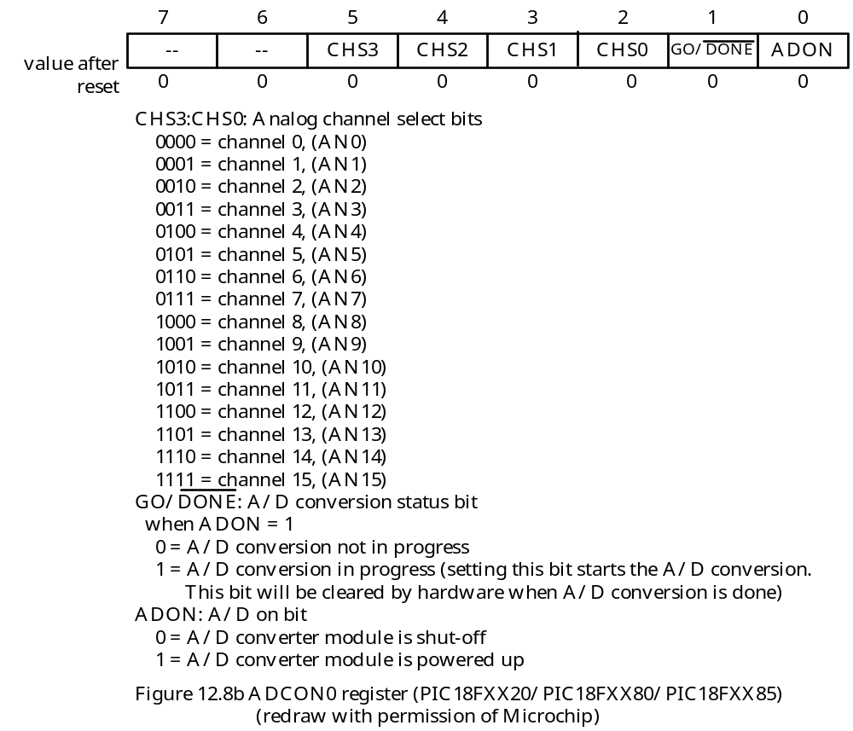
Copyright @ 2005 Delmar Thompson

Slide 19
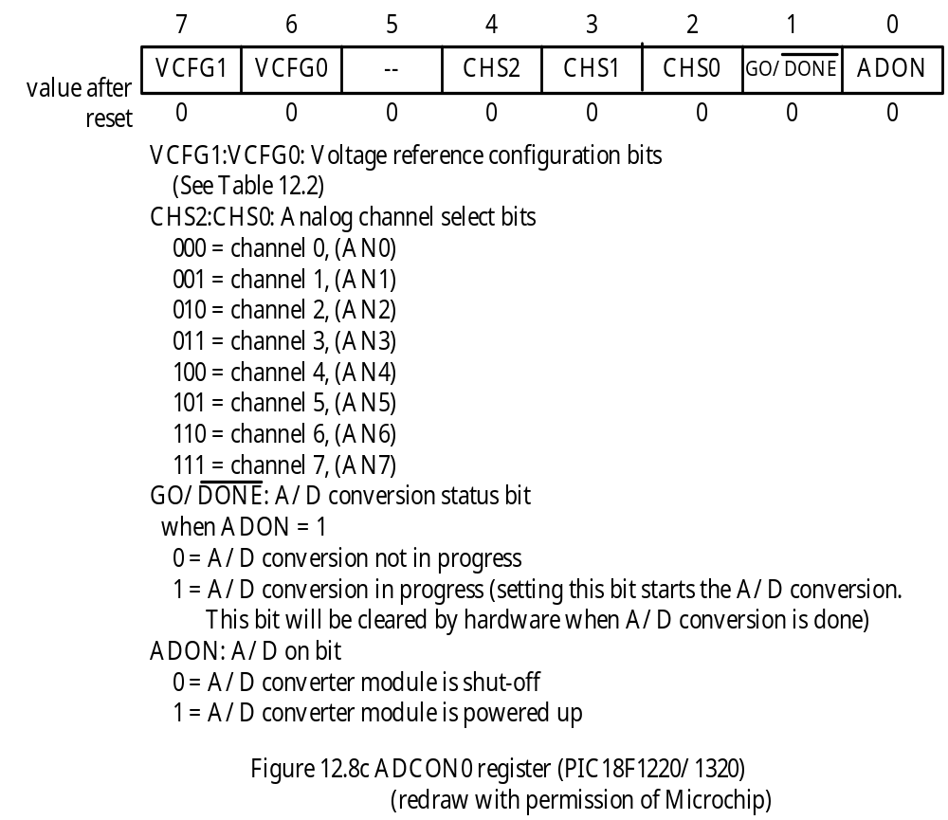
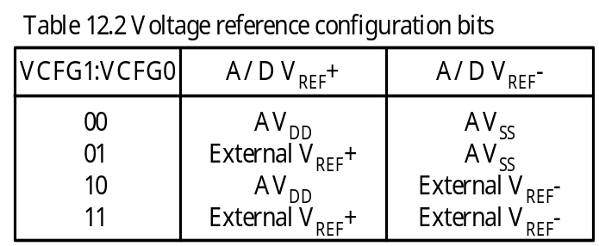
Copyright @ 2005 Delmar Thompson

Slide 20
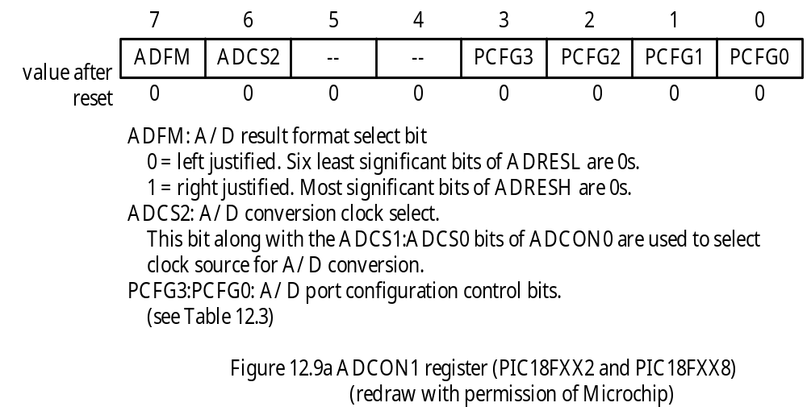
ADCON1 Register
Configure an input pin as analog or digit.
An input to be converted must be an analog input.
Copyright @ 2005 Delmar Thompson

Slide 21
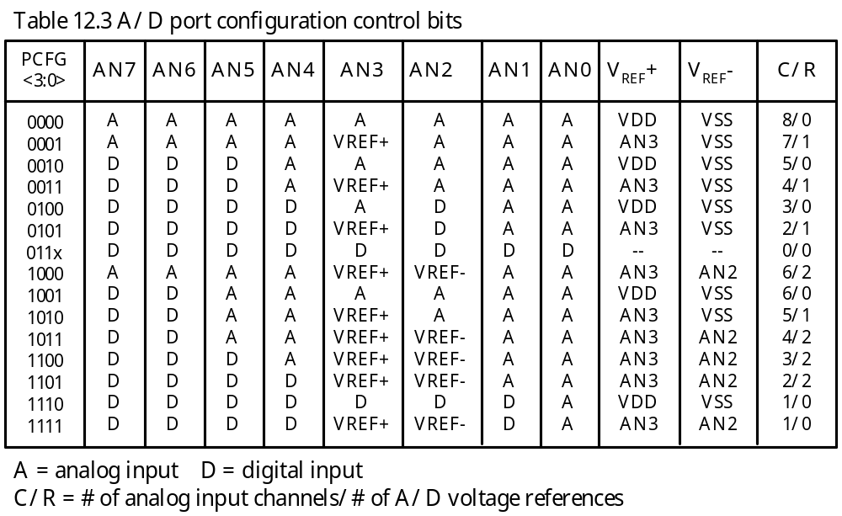
Copyright @ 2005 Delmar Thompson

Slide 22
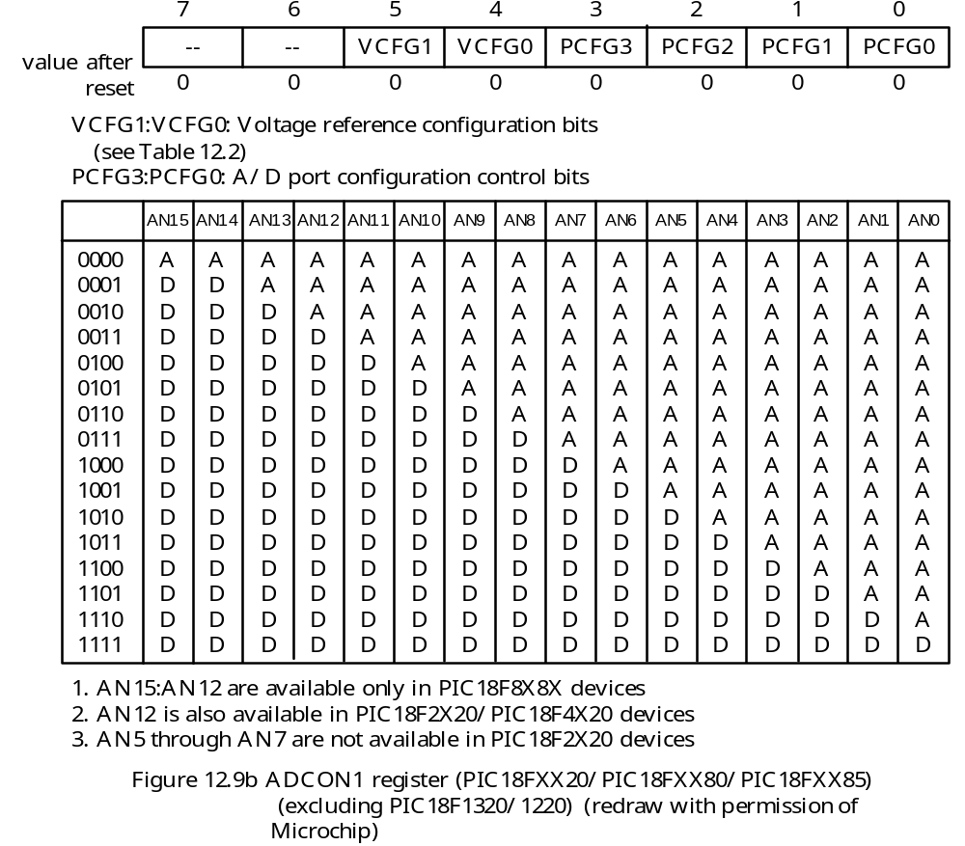
Copyright @ 2005 Delmar Thompson

Slide 23
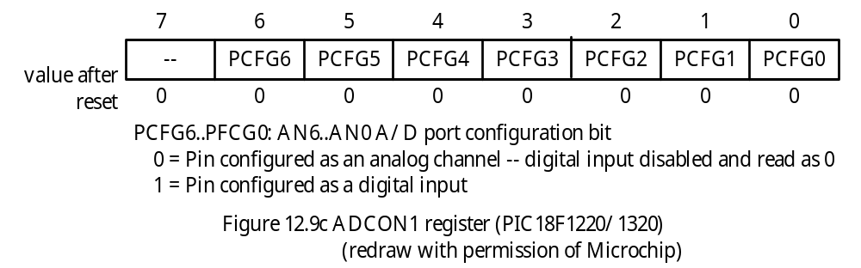
Copyright @ 2005 Delmar Thompson

Slide 24
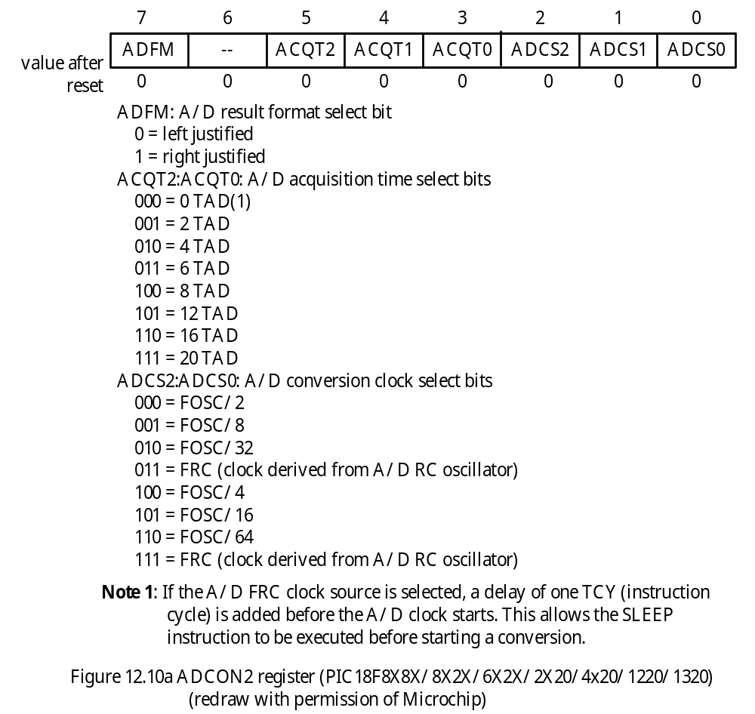
ADCON2 Register
Copyright @ 2005 Delmar Thompson

Slide 25
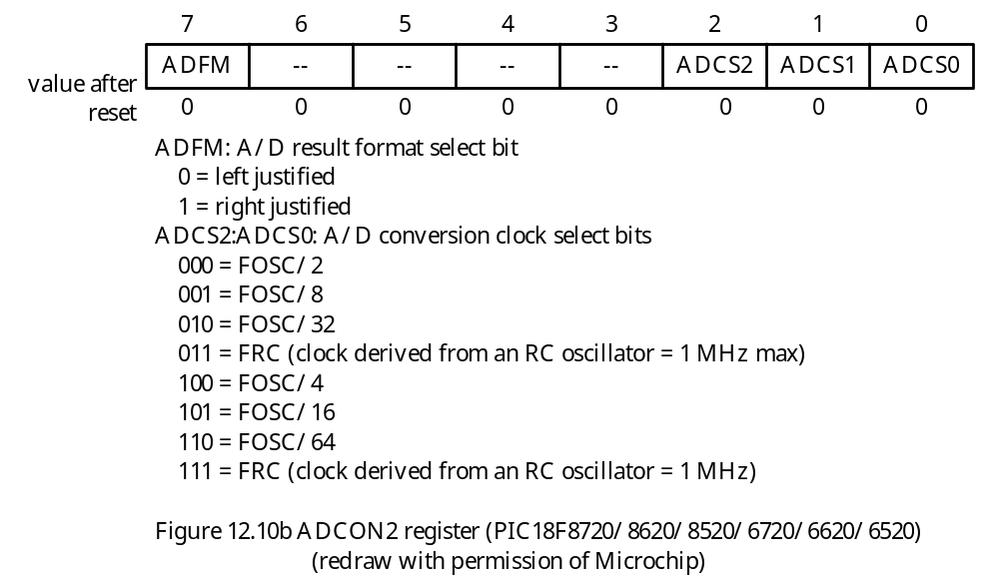
Copyright @ 2005 Delmar Thompson

Slide 26
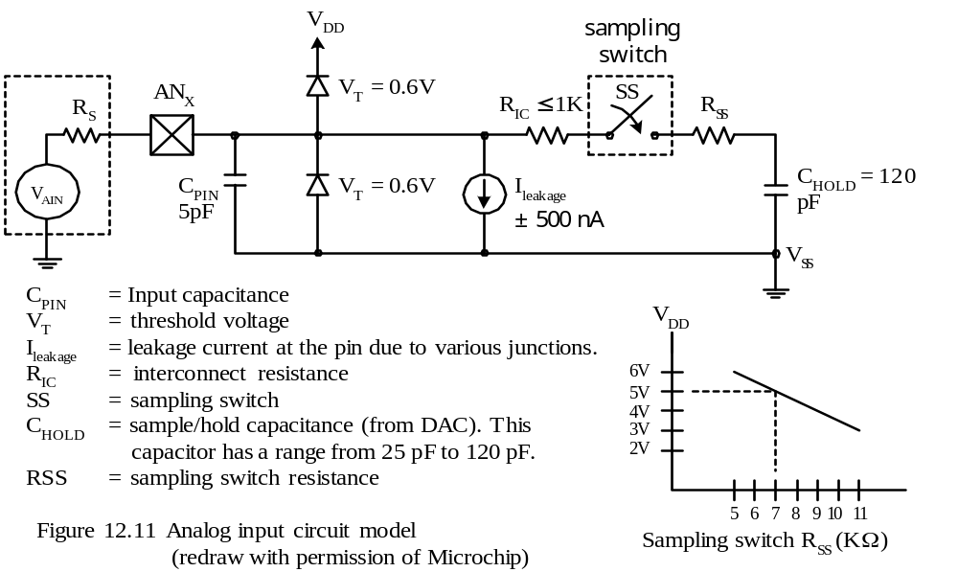
A/D Acquisition Requirements
The A/D converter has a sample-and-hold circuit for analog input.
The sample-and-hold circuit keeps the voltage stable when it is converted.
The sample-and-hold circuit is shown in Figure 12.11.
Copyright @ 2005 Delmar Thompson

Slide 27
The capacitor C_{HOLD} holds the voltage to be converted.
The required minimum acquisition time T_{ACQ} is computed as follows:
TACQ = amplifier settling time + holding capacitor charging time + temperature coefficient
= T_{AMP} + T_{C} + T_{COFF}
where,
T_{AMP} = 2 μs
T_{COFF} = (temp – 25ºC) × (0.05 μs/ºC) , 0 for temp < 25ºC.
T_{C} = 120 pF × (1 KΩ + R_{SS} + R_{S}) log (2047)
= 120 pF × (1 KΩ +7KΩ + 2 KΩ) = 9.61 μs
Copyright @ 2005 Delmar Thompson

Slide 28
Automatic Acquisition Time
For earlier PIC18 members, when the GO/DONE bit is set, sampling is stopped and conversion begins.
The user is responsible for making sure enough acquisition time is provided.
For newer PIC18 members, the A/D module will continue to sample after the GO/DONE bit is set for the selected acquisition time.
The automatic acquisition time makes A/D programming a little easier.
Selecting the A/D Conversion Clock
The per bit A/D conversion time is defined as T_{AD}.
Each 10-bit A/D conversion takes 12 T_{AD} to complete.
For some devices, the options for T_{AD} are defined in ADCON0. For others, the options for T_{AD} are defined in ADCON2.
The length of T_{AD} must be at least 1.6 μs.
The options for T_{AD} versus crystal oscillator frequency are listed in Table 12.4
Copyright @ 2005 Delmar Thompson

Slide 29
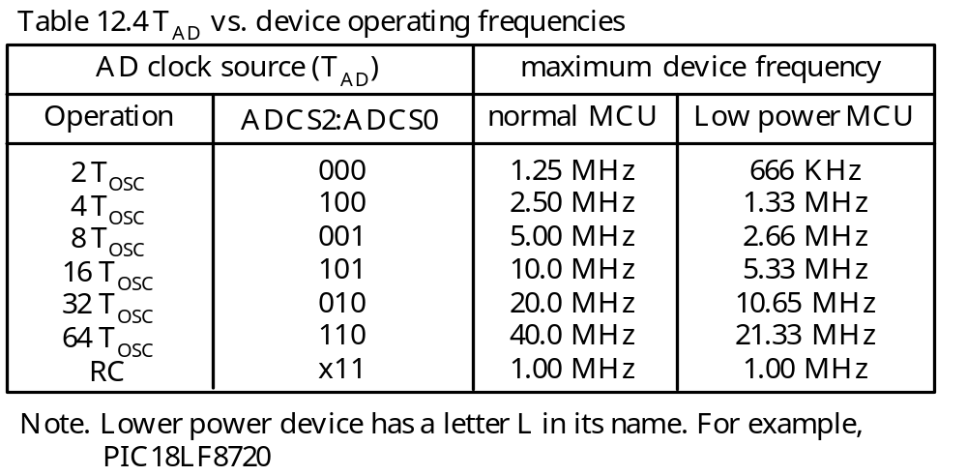
A/D Conversion Operation
For PIC18 members without the feature of automatic acquisition, A/D conversion will start immediately after setting the GO/DONE bit.
For devices with automatic acquisition, the device will continue to perform data acquisition until the preprogrammed time is up and then start the A/D conversion.
Copyright @ 2005 Delmar Thompson

Slide 30
Example 12.4 Write an instruction sequence to configure the A/D converter of the PIC18F8680 to operate with the following parameters:
Conversion result right justified
f_{OSC} = 32 MHz
The highest ambient temperature may reach 60ºC
Use V_{DD} and V_{SS} as the high and low reference voltages
Convert channel AN0
Enable A/D module
Solution:
- T_{COFF} = (60 -25) × 0.05 = 1.75 μs
- The required acquisition time = (9.61 + 2 + 1.75) = 13.36 μs.
- f_{OSC} = 32 MHz, the A/D clock source must be set to 64 f_{OSC}, which makes T_{AD} = 2μs.
- PIC18F8680 supports automatic acquisition time, it must be set to at least 8 T_{AD} to make it greater than 13.36 μs
Copyright @ 2005 Delmar Thompson

Slide 31
Assembly instruction sequence that achieve the desired setting:
movlw 0x01 ; select channel AN0 and enable A/D
movwf ADCON0,A ; “
movlw 0x0E ; configure only channel AN0 as analog port,
movwf ADCON1,A ; select V_{DD} and V_{SS} as reference voltage
movlw 0xA6 ; set A/D result right justified, set acquisition
movwf ADCON2,A ; time to 8 TAD, clock source F_{OSC}/64
In C language,
ADCON0 = 0x01;
ADCON1 = 0x0E;
ADCON2 = 0xA6;
Copyright @ 2005 Delmar Thompson

Slide 32
Example 12.5 Write an instruction sequence to configure the A/D converter of the PIC18F452 to operate with the following parameters:
Conversion result right justified
f_{OSC} = 32 MHz
The highest ambient temperature may reach 60ºC
Use V_{DD} and V_{SS} as the high and low reference voltages
Convert channel AN0
Enable A/D module
Solution:
movlw 0x81 ; select f_{OSC}/64 as the conversion clock
movwf ADCON0,A ; “
movlw 0xCE ; A/D conversion result right justified
movwf ADCON1,A ; configure only AN0 pin as analog,
Copyright @ 2005 Delmar Thompson

Slide 33
Procedure for Performing A/D Conversion
Configure the A/D module
1. Configure analog pins, reference voltages
2. Select A/D input channel
3. Select A/D acquisition time (if available)
4. Select A/D conversion clock
5. Enable A/D module
Configure A/D interrupt
1. Clear ADIF flag
2. Set ADIE bit (if desired)
3. Set GIE bit (if desired)
Wait for the desired acquisition time (if required)
Start conversion by setting the GO/DONE bit
Wait for A/D conversion to complete
Read the A/D result registers; clear the ADIF flag
For next conversion, go to step 1 or step 2.
Copyright @ 2005 Delmar Thompson

Slide 34
Example 12.6 Assume that the AN0 pin of a PIC18F8680 running with a 32 MHz crystal oscillator is connected to a potentiometer. The voltage range of the potentiometer is from 0V to 5V. Write a program to measure the voltage applied to the AN0 pin, convert it, and retrieved the conversion result and place it in PRODH:PRODL.
Solution:
Copyright @ 2005 Delmar Thompson

Slide 35
#include <p18F8680.inc>
org 0x00
goto start
org 0x08
retfie
org 0x18
retfie
start movlw 0x01 ; select channel AN0 and enable A/D
movwf ADCON0,A ; "
movlw 0x0E ; use VDD & VSS as reference voltages &
movwf ADCON1,A ; configure channel AN0 as analog input
movlw 0xA6 ; select F_{OSC}/64 as conversion clock,
movwf ADCON2,A ; 8 T_{AD} for acquisition time, right-justified
bsf ADCON0,GO,A ; start A/D conversion
wait_con btfsc ADCON0,DONE,A ; wait until conversion is done
bra wait_con
movff ADRESH,PRODH ; save conversion result
movff ADRESL,PRODL ; "
end
Copyright @ 2005 Delmar Thompson

Slide 36
A/D Converter C Library Functions
char BusyADC (void);
- Returns a 1 if the A/D module is busy. Returns a 0 if not.
void CloseADC (void);
- Disable the A/D module.
void ConvertADC (void);
- Start an A/D conversion
int ReadADC (void);
- Reads the A/D conversion result
void SetChanADC (unsigned char channel);
- Selects the pin used as input to the A/D converter. The channel value can be from ADC_CH0 through ADC_CH15.
void OpenADC (unsigned char config, unsigned char config2);
- The setting of config and config2 depends on the device.
- The PIC18F1X20/2X20/3X20/4X20 have a third argument: portconfig.
- The values of these arguments are in the following slides
Copyright @ 2005 Delmar Thompson

Slide 37
PIC18FXX2, PIC18FXX2, and PIC18FXX8
The first argument config may have the following values:
A/D clock source
ADC_FOSC_2 FOSC/2
ADC_FOSC_4 FOSC/4
ADC_FOSC_8 FOSC/8
ADC_FOSC_16 FOSC/16
ADC_FOSC_32 FOSC/32
ADC_FOSC_64 FOSC/64
ADC_FOSC_RC Internal RC Oscillator
A/D result justification
ADC_RIGHT_JUST Result in least significant bits
ADC_LEFT_JUST Result in most significant bits
Copyright @ 2005 Delmar Thompson

Slide 38
A/D voltage reference source
ADC_8ANA_0REF VREF+ = VDD, VREF- = VSS, all analog channels
ADC_7ANA_1REF AN3 = VREF+, all analog channels except AN3
ADC_6ANA_2REF AN3 = VREF+, AN2 = VREF-
ADC_6ANA_0REF VREF+ = VDD, VREF- = VSS
ADC_5ANA_1REF AN3 = VREF+, VREF- = VSS
ADC_5ANA_0REF VREF+ = VDD, VREF- = VSS
ADC_4ANA_2REF AN3 = VREF+, AN2 = VREF-
ADC_4ANA_1REF AN3 = VREF+
ADC_3ANA_2REF AN3 = VREF+, AN2 = VREF-
ADC_3ANA_0REF VREF+ = VDD, VREF- = VSS
ADC_2ANA_2REF AN3 = VREF+, AN2 = VREF-
ADC_2ANA_1REF AN3 = VREF+
ADC_1ANA_2REF AN3 = VREF+, AN2 = VREF-, AN0 = A
ADC_1ANA_0REF AN0 is analog input
ADC_0ANA_0REF All digital I/O
Copyright @ 2005 Delmar Thompson

Slide 39
The second argument config2 may have the following values:
Channel
ADC_CH0 Channel 0
ADC_CH1 Channel 1
ADC_CH2 Channel 2
ADC_CH3 Channel 3
ADC_CH4 Channel 4
ADC_CH5 Channel 5
ADC_CH6 Channel 6
ADC_CH7 Channel 7
A/D Interrupts
ADC_INT_ON Interrupts enabled
ADC_INT_OFF Interrupts disabled
Copyright @ 2005 Delmar Thompson

Slide 40
PIC18C658/858, PIC18C601/801, PIC18F6X20, PIC18F8X20
The first argument config may have the following values:
A/D clock source
ADC_FOSC_2 FOSC/2
ADC_FOSC_4 FOSC/4
ADC_FOSC_8 FOSC/8
ADC_FOSC_16 FOSC/16
ADC_FOSC_32 FOSC/32
ADC_FOSC_64 FOSC/64
ADC_FOSC_RC Internal RC oscillator
A/D result justification
ADC_RIGHT_JUST Result in least significant bits
ADC_LEFT_JUST Result in most significant bits
Copyright @ 2005 Delmar Thompson

Slide 41
A/D port configuration
ADC_0ANA All digital
ADC_1ANA analog AN0 digital: AN1—AN15
ADC_2ANA analog AN0-AN1 digital: AN2—AN15
ADC_3ANA analog AN0-AN2 digital: AN3—AN15
ADC_4ANA analog AN0-AN3 digital: AN4—AN15
ADC_5ANA analog AN0-AN4 digital: AN5—AN15
ADC_6ANA analog AN0-AN5 digital: AN6—AN15
ADC_7ANA analog AN0-AN6 digital: AN7—AN15
ADC_8ANA analog AN0-AN7 digital: AN8—AN15
ADC_9ANA analog AN0-AN8 digital: AN9—AN15
ADC_10ANA analog AN0-AN9 digital: AN10—AN15
ADC_11ANA analog AN0-AN10 digital: AN11—AN15
ADC_12ANA analog AN0-AN11 digital: AN12—AN15
ADC_13ANA analog AN0-AN12 digital: AN13—AN15
ADC_14ANA analog AN0-AN13 digital: AN14—AN15
ADC_15ANA all analog
Copyright @ 2005 Delmar Thompson

Slide 42
The second argument config2 has the following values:
Channel
ADC_CH0 Channel 0
ADC_CH1 Channel 1
ADC_CH2 Channel 2
ADC_CH3 Channel 3
ADC_CH4 Channel 4
ADC_CH5 Channel 5
ADC_CH6 Channel 6
ADC_CH7 Channel 7
ADC_CH8 Channel 8
ADC_CH9 Channel 9
ADC_CH10 Channel 10
ADC_CH11 Channel 11
ADC_CH12 Channel 12
ADC_CH13 Channel 13
ADC_CH14 Channel 14
ADC_CH15 Channel 15
A/D Interrupts
ADC_INT_ON Interrupts enabled
ADC_INT_OFF Interrupts disabled
Copyright @ 2005 Delmar Thompson

Slide 43
A/D voltage configuration
ADC_VREFPLUS_VDD VREF+ = AVDD
ADC_VREFPLUS_EXT VREF+ = external
ADC_VREFMINUS_VSS VREF- = AVSS
ADC_VREFMINUS_EXT VREF- = external
PIC18F6X8X, PIC18F8X8X, PIC18F1X20, PIC18F2X20, PIC18F4X20
The first argument config may have the following values:
A/D clock source
ADC_FOSC_2 FOSC/2
ADC_FOSC_4 FOSC/4
ADC_FOSC_8 FOSC/8
ADC_FOSC_16 FOSC/16
ADC_FOSC_32 FOSC/32
ADC_FOSC_64 FOSC/64
ADC_FOSC_RC Internal RC oscillator
A/D result justification
ADC_RIGHT_JUST Result in least significant bits
ADC_LEFT_JUST Result in most significant bits
Copyright @ 2005 Delmar Thompson

Slide 44
A/D acquisition time select
ADC_0_TAD 0 Tad
ADC_2_TAD 2 Tad
ADC_4_TAD 4 Tad
ADC_6_TAD 6 Tad
ADC_8_TAD 8 Tad
ADC_12_TAD 12 Tad
ADC_16_TAD 16 Tad
ADC_20_TAD 20 Tad
The second argument config2 may have the following values:
Channel
ADC_CH0 Channel 0
ADC_CH1 Channel 1
ADC_CH2 Channel 2
ADC_CH3 Channel 3
ADC_CH4 Channel 4
ADC_CH5 Channel 5
ADC_CH6 Channel 6
ADC_CH7 Channel 7
ADC_CH8 Channel 8
ADC_CH9 Channel 9
ADC_CH10 Channel 10
Copyright @ 2005 Delmar Thompson

Slide 45
ADC_CH11 Channel 11
ADC_CH12 Channel 12
ADC_CH13 Channel 13
ADC_CH14 Channel 14
ADC_CH15 Channel 15
A/D Interrupts
ADC_INT_ON Interrupts enabled
ADC_INT_OFF Interrupts disabled
A/D voltage configuration
ADC_VREFPLUS_VDD VREF+ = AVDD
ADC_VREFPLUS_EXT VREF+ = external
ADC_VREFMINUS_VSS VREF- = AVSS
ADC_VREFMINUS_EXT VREF- = external
The third argument portconfig is any value from 0 to 127 for the PIC18F1220/1320.
The argument portconfig is any value from 0 to 15 for the PIC2220/2320/4220 and PIC18F4320/6X8X/8X8X.
Copyright @ 2005 Delmar Thompson

Slide 46
Example 12.7 Write a C program to configure the A/D module of the PIC18F452 with the following characteristics and take one sample, convert it, and store the result in a memory location:
Clock source set to F_{OSC}/64
Result right justified
Set AN0 pin of port A for analog input, others for digital
Use V_{DD} and V_{SS} as high and low reference voltages
Select AN0 to convert
Disable interrupt
Solution:
Copyright @ 2005 Delmar Thompson

Slide 47
#include <p18F452.h>
#include <adc.h>
#include <stdlib.h>
#include <delays.h>
int result;
void main (void)
{
OpenADC(ADC_FOSC_64 & ADC_RIGHT_JUST & ADC_1ANA_0REF,
ADC_CH0 & ADC_INT_OFF);
Delay10TCYx(20); // provides 200 instruction cycles of acquisition time
ConvertADC( ); // start A/D conversion
while(BusyADC( )); // wait for completion
result = ReadADC( ); // read result
CloseADC( );
}
Copyright @ 2005 Delmar Thompson

Slide 48
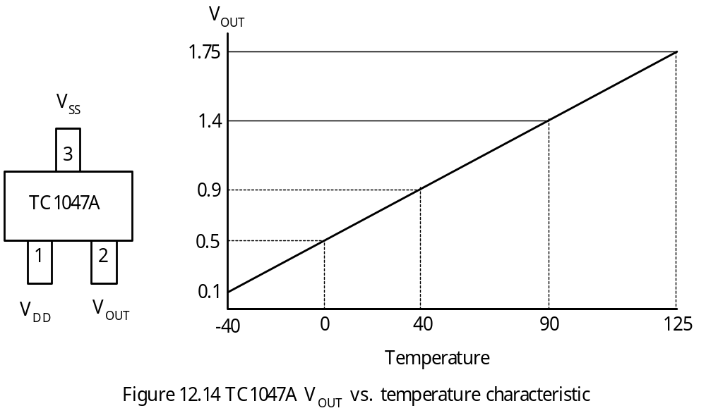
Using the Temperature Sensor TC1047A
Can measure temperature from -40ºC to 125ºC
The voltage output of this sensor is 0.1V at -40ºC, 1.75V at 125ºC.
Copyright @ 2005 Delmar Thompson

Slide 49
Example 12.8 Describe a circuit connection and the required program to build a digital thermometer. Display the temperature in three integral and one fractional digits using the LCD. Measure and display the temperature over the whole range of TC1047A; that is, -40ºC to +125ºC. Update the display data ten times per second and assume that the PIC18F8680 operates with a 32 MHz crystal oscillator.
Solution:
A signal conditioning circuit is needed to shift and scale the output of the TC1047A to 0 ~ 5V.
To convert the A/D conversion result back to the corresponding temperature, perform the following operations:
1. Divide the conversion result by 6.2
2. Subtract the quotient by 40
The operation of “divide by 6.2” can be implemented by
1. Multiplying the conversion result by 10
2. Dividing the product by 62
- The digital thermometer circuit is shown in Figure 12.15.
Copyright @ 2005 Delmar Thompson

Slide 50
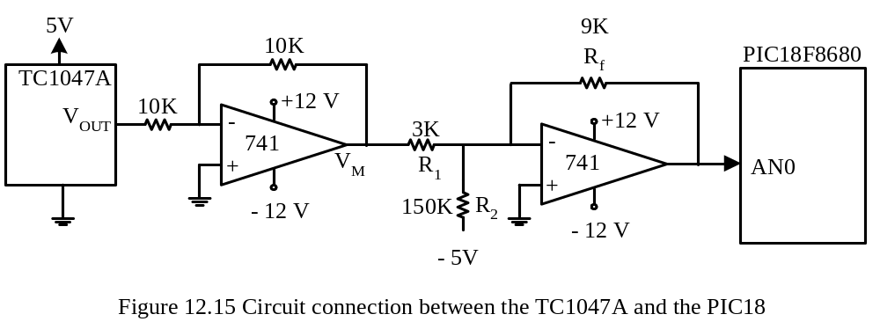
The Procedure
Step 1
Configure A/D converter and Timer0 properly. Timer0 is configured to overflow every 200 ms.
Step 2
Start an A/D conversion.
Step 3
Wait until the A/D conversion is complete.
Step 4
Multiply the conversion result by 10.
Copyright @ 2005 Delmar Thompson

Slide 51
Step 5
Divide the product resulted in step 4 by 62 to obtain temperature reading. Use variables quo and rem to hold the quotient and remainder.
Step 6
Subtract 40 from the variable quo to obtain the actual temperature.
Step 7
If (quo > 0), go to step 9; else replace quo with its two’s complement.
Step 8
If rem ≠ 0, then
  decrement quo by 1
  rem ← 62 – rem.
Step 9
Compute the fractional digit by multiplying rem by 10 and then dividing the resulted product by 62.
Step 10
Compute the integral digits by performing repeated division by 10 to quo.
Step 11
Wait until Timer0 overflows and then go to Step 2.
Copyright @ 2005 Delmar Thompson

Slide 52
#include <p18F8680.inc>
; -----
; include macro definitions for pushr, push_dat, popr, alloc_stk, dealloc_stk here.
; -----
; ********************************************************************
; The following definitions are used by the 16-bit multiplication routine
; ********************************************************************
loc_varm equ 4 ; number of bytes used for local variable
pd0 equ 7 ; offset of PD3 from frame pointer
pd1 equ 6 ; offset of PD2 from frame pointer
pd2 equ 5 ; offset of PD1 from frame pointer
pd3 equ 4 ; offset of PD0 from frame pointer
MD_lo equ -8 ; offset of MD_lo from frame pointer
MD_hi equ -7 ; offset of MD_hi from frame pointer
ND_lo equ -6 ; offset of ND_lo from frame pointer
ND_hi equ -5 ; offset of ND_hi from frame pointer
buf_lo equ -4
buf_hi equ -3
ptr_hi equ 0x01 ; address of buffer to hold product
ptr_lo equ 0x00 ; "
Copyright @ 2005 Delmar Thompson

Slide 53
; ********************************************************************
; The following definitions are used by the 16-bit unsigned divide routine
; ********************************************************************
loc_var equ 2 ; local variable size
lp_cnt equ 1 ; loop count
temp equ 2 ; temporary storage
quo_hi equ -7 ; offset for quotient and dividend from frame
quo_lo equ -8 ; pointer
rem_hi equ -5 ; offset for remainder from frame pointer
rem_lo equ -6 ; "
dsr_hi equ -3 ; offset for divisor from frame pointer
dsr_lo equ -4 ; "
quo set 0x02 ; memory space to hold the quotient
rem set 0x04 ; memory space to hold the remainder
; ************************************************************************
; variables for holding temperature conversion result and string
; ************************************************************************
int_pt set 0x06 ; space to hold integer part of the temperature
temp_buf set 0x08 ; reserve 6 bytes to hold the temperature
; digits, sign, period, and NULL
Copyright @ 2005 Delmar Thompson

Slide 54
org 0x00 ; reset vector
goto start
org 0x08
retfie
org 0x18
retfie
start lfsr FSR1,0xC00 ; set up stack pointer
; initialize the temperature string to ^^0.0
call a2d_init ; configure and turn on A/D module
forever movlw 0x20 ; store space character
movwf temp_buf ; "
movwf temp_buf+1 ; "
movlw 0x30 ; store a 0 digit
movwf temp_buf+2 ; "
movwf temp_buf+4 ; "
movlw 0x2E ; store a period
movwf temp_buf+3 ; "
clrf temp_buf+5 ; terminate the string with a NULL character
call OpenTmr0 ; initialize and enable Timer0
bsf ADCON0,GO,A ; start A/D conversion
Copyright @ 2005 Delmar Thompson

Slide 55
wait_a2d btfsc ADCON0,DONE,A ; wait until A/D conversion is complete
bra wait_a2d ; "
pushr ADRESL ; push the A/D conversion result in
pushr ADRESH ; stack
push_dat 0x0A ; push 10 in the stack for multiplier
push_dat 0x00 ; "
push_dat ptr_lo ; pass buffer pointer to the subroutine
push_dat ptr_hi ; "
call mul_16U,FAST ; multiply A/D conversion result by 10
dealloc_stk 6 ; deallocate space used in the stack
movlw ptr_lo ; place the address of product in FSR0
movwf FSR0L,A ; "
movlw ptr_hi ; "
movwf FSR0H,A ; "
movf POSTINC0,W,A ; push (A/D result x 10)
pushr WREG ; "
movf INDF0,W,A ; "
pushr WREG ; "
alloc_stk 2
push_dat 0x3E ; push 62 into the stack as the divisor
push_dat 0 ; "
call div16u,FAST ;
Copyright @ 2005 Delmar Thompson

Slide 56
dealloc_stk 2
popr rem+1 ; retrieve remainder high byte (should be 0)
popr rem ; retrieve remainder low byte
popr int_pt+1 ; retrieve integer part of the (should be 0)
popr int_pt ; temperature
; subtract 40 from integer part to obtain the actual temperature
movlw 0x28 ; calculate the actual temperature
subwf int_pt,F,A ; "
bnn non_minus ; if non-minus, no need for further check
negf int_pt,A ; find the magnitude of temperature
movlw 0x2D
movlw temp_buf ; store the minus sign
movf rem,W,A ; check the fractional part before divide
bz separate_dd ; branch to separate integer digits if rem = 0
decf int_pt,F,A ; fractional digit ≠ 0, decrement integer part
movlw 0x3E ; need to find the complement of the fractional
subwf rem,F,A ; digit
negf rem,A ; "
; calculate the fractional digit
non_minus
movlw 0x0A
mulwf rem
Copyright @ 2005 Delmar Thompson

Slide 57
pushr PRODL ; push (remainder x 10)
pushr PRODH ; "
alloc_stk 2
push_dat 0x3E ; push 62 into the stack as the divisor
push_dat 0 ; "
call div16u,FAST ;
dealloc_stk 2
popr rem+1 ; retrieve remainder high byte (= 0)
popr rem ; retrieve remainder low byte
popr quo+1 ; retrieve quotient high byte (= 0)
popr quo ; retrieve quotient low byte
; round the fractional digit
movlw 0x1F ; is remainder >= 31?
cpfslt rem,A ; smaller, then skip
incf quo,A
movlw 0x0A ; is quo equal to 10?
cpfseq quo,F,A
goto no_round
clrf quo,A
incf int_pt,A
no_round movlw 0x30 ; convert to ASCII of BCD digit
addwf quo,F,A
Copyright @ 2005 Delmar Thompson

Slide 58
movwf temp_buf+4 ; save the ASCII of the fractional digit
; separate the integral digits using repeated division by 10
separate_dd
pushr int_pt ; push integer part
push_dat 0 ; "
alloc_stk 2
push_dat 0x0A ; push 10 as the divisor
push_dat 0 ; "
call div16u,FAST
dealloc_stk 2
popr rem+1
popr rem
popr quo+1
popr quo
movlw 0x30
addwf rem,W,A
movwf temp_buf+2 ; save the one's digit
movf quo,W,A ; check the quotient
bz next_time ; wait to perform next conversion
; prepare to separate ten's digit
movlw 0x0A ; is the quotient >= 10?
cpfslt quo,A ; "
Copyright @ 2005 Delmar Thompson

Slide 59
goto yes_ge
movlw 0x30
addwf quo,W,A
movwf temp_buf+1 ; save the ten's digit
goto next_time ; "
yes_ge movlw 0x31 ; save "1" as the hundred's digit
movwf temp_buf,A ; "
movlw 0x0A ; separate the ten's digit and place it
subwf quo,W,A ; in WREG
addlw 0x30 ; convert ten's digit to ASCII and
movwf temp_buf+1,A ; save ten's digit
next_time btfss INTCON,TMR0IF,A ; wait until 200 ms is over
goto next_time
; -----
; add instructions to update display here
; -----
goto forever ; prepare to perform next A/D conversion
Copyright @ 2005 Delmar Thompson

Slide 60
; *********************************************************************
; This routine will place 15535 in TMR0 so that it overflows in 50000 count.
; When prescaler is set to 32 with fOSC = 32MHz, it will overflow in 200 ms.
; *******************************************************************
OpenTmr0 movlw 0x3C ; place 15535 in TMR0
movwf TMR0H ; so that it overflows in
movlw 0xAF ; 200 ms
movwf TMR0L ; "
movlw 0x84 ; enable TMR0, select internal clock,
movwf T0CON ; set prescaler to 32
bcf INTCON,TMR0IF ; clear TMR0IF flag
return
; ************************************************************
; This routine initialize the A/D converter to select channel AN0 as
; analog input other pins for digital pin. Select VDD and VSS as A/D
; conversion reference voltages, result right justified, FOSC/64 as
; A/D clock source, 8 TAD for acquisition time.
; *************************************************************
a2d_init movlw 0x01 ; select channel AN0
movwf ADCON0 ; and enable A/D module
movlw 0x0E ; use VDD & VSS as A/D reference voltage
movwf ADCON1 ; & configure AN0 as analog input
Copyright @ 2005 Delmar Thompson

Slide 61
movlw 0xA6 ; result right justified, FOSC/64 as A/D clock
movwf ADCON2 ; source and set acquisition time to 8 TAD
return
; -----
; include subroutines div16u and mul_16U here.
; -----
end
Copyright @ 2005 Delmar Thompson

Slide 62
#include <p18F8680.h>
#include <timers.h>
#include <adc.h>
unsigned char temp_buf[6];
void main (void)
{
int a2d_val;
unsigned int quo, rem;
char fd1, fdr;
ADCON0 = 0x01; //select channel AN0, enable A/D module
ADCON1 = 0x0E; //use VDD, VSS as reference and configure AN0 for analog
ADCON2 = 0xA6; //result right justified, 8TAD acquisition time, FOSC/64
OpenTimer0(TIMER_INT_OFF & T0_16BIT & T0_SOURCE_INT &
T0_PS_1_32); //start Timer0 and make it overflow in 200 ms
while (1) {
temp_buf[5] = '\0';
temp_buf[0] = 0x20; //set to space
temp_buf[1] = 0x20; //set to space
temp_buf[2] = 0x30; //set to digit 0
temp_buf[3] = 0x2E; //store the decimal point
temp_buf[4] = 0x30; //set to digit 0
ConvertADC( ); //start an A/D conversion
Copyright @ 2005 Delmar Thompson

Slide 63
while(BusyADC()); //wait until A/D conversion is done
a2d_val = 10 * ReadADC();
quo = a2d_val / 62; //convert to temperature
rem = a2d_val % 62;
if (quo < 40) //is temperature minus?
{
quo = 40 - quo;
temp_buf[0] = 0x2D;//set sign to minus
if (rem != 0)
{
quo --;
rem = 62 - rem;
}
}
fd1 = (rem * 10) / 62; //fd1 will be between 0 and 9
fdr = (rem * 10) % 62;
if (fdr >= 31)
fd1 ++;
if (fd1 == 10) { //fractional digit can only be between 0 and 9
quo++;
fd1 = 0;
}
Copyright @ 2005 Delmar Thompson

Slide 64
temp_buf[4] = 0x30 + fd1; //store the ASCII code of fractional digit
temp_buf[2] = quo % 10 + 0x30; //store ASCII code of one’s digit
quo = quo / 10;
if (quo != 0)
{
temp_buf[1] = (quo - 10) + 0x30; //ten’s digit of temperature
quo -= 10;
}
if (quo == 1)
temp_buf[0] = 0x31; //hundred’s digit of temperature
while(!INTCONbits.TMR0IF); //wait until Timer0 overflows
INTCONbits.TMR0IF = 0; //clear the TMR0IF flag
}
}
Copyright @ 2005 Delmar Thompson

Slide 65
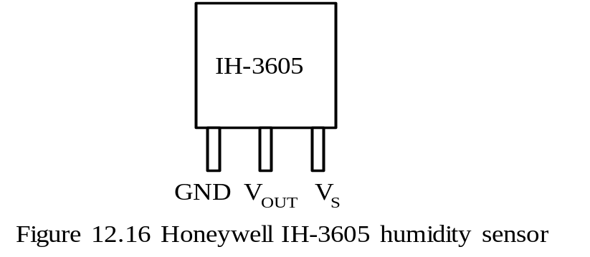
Using the IH-3606 Humidity Sensor
Voltage output is 0.8V to 3.9V for the relative humidity from 0 to 100%
Can resist contaminant vapors such as organic solvent, chlorine, and ammonia.
A 3-pin device
Light sensitive and should be shielded from bright light
Pin assignment is shown in Figure 12.16.
Characteristics are listed in Table 12.5.
Copyright @ 2005 Delmar Thompson

Slide 66
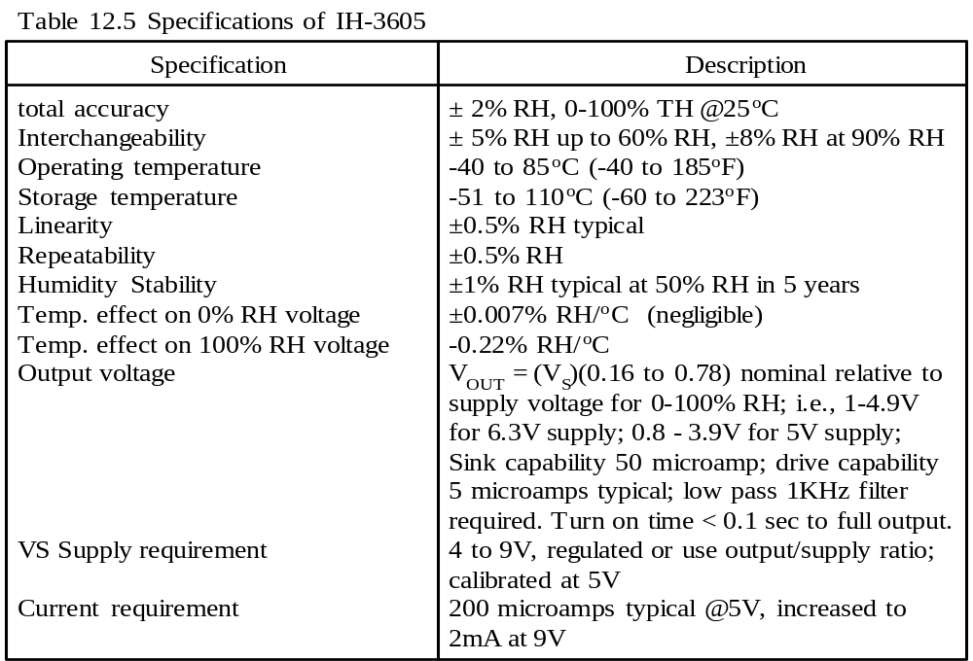
Copyright @ 2005 Delmar Thompson

Slide 67
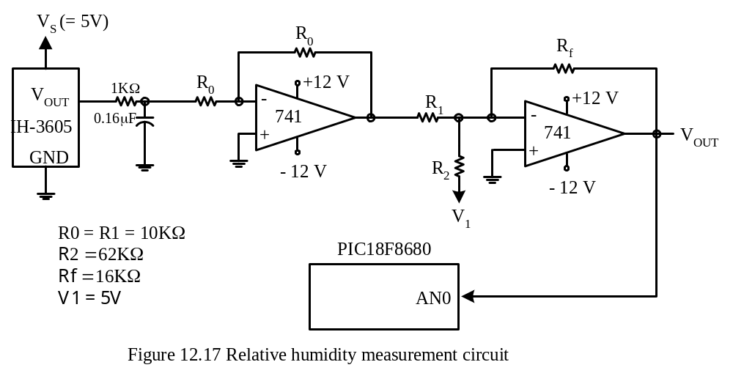
Example 12.9 Construct a humidity measurement system that consists of the PIC18F8680, an IH-3605 humidity sensor, and an LCD. The PIC18F8680 is running with a 32 MHz crystal oscillator.
Solution:
It is beneficial to scale and shift the humidity sensor output to the range of 0~5V.
A 1-KHz low pass filter is needed at the output of the humidity sensor.
To convert to the relative humidity, divide the A/D conversion result by 10.23.
The humidity data will be represented using an LCD or four seven-segment displays.
Copyright @ 2005 Delmar Thompson

Slide 68
#include <p18F8680.h>
#include <timers.h>
#include <adc.h>
unsigned char hum_buf[6]; //buffer to hold relative humidity
void main (void)
{
unsigned short long a2d_val;
unsigned short long quo, rem, temp1;
char fd1, i;
ADCON0 = 0x01; //select channel AN0, enable A/D module
ADCON1 = 0x0E; //use VDD, VSS as reference and configure AN0 for analog
ADCON2 = 0xA6; //result right justified, acquisition time = 8 TAD, FOSC/64
OpenTimer0(TIMER_INT_OFF & T0_16BIT & T0_SOURCE_INT &
T0_PS_1_32); //start Timer0 and make it overflow in 200 ms
while (1) {
hum_buf[0] = 0x20; //set to space
hum_buf[1] = 0x20; //set to space
hum_buf[2] = 0x30; //set to digit 0
hum_buf[3] = 0x2E; //store the decimal point
hum_buf[4] = 0x30; //set to digit 0
hum_buf[5] = '\0'; //terminate with a NULL character
ConvertADC( ); //start an A/D conversion
while (BusyADC( )); //wait until A/D conversion is done
Copyright @ 2005 Delmar Thompson

Slide 69
a2d_val = 100 * ReadADC();
quo = a2d_val / 1023; //convert to relative humidity
rem = a2d_val % 1023; // "
fd1 = (rem * 10) / 1023; //compute the fractional digit
temp1 = (rem * 10) % 1023;
if (temp1 > 511) //should round up the fractional digit
fd1 ++;
if (fd1 == 10) { //if fractional digit becomes 10, zero it
fd1 = 0; // and add 1 to integer part
quo++;
}
hum_buf[4] = 0x30 + fd1; //ASCII code of fractional digit
hum_buf[2] = quo % 10 + 0x30; //ASCII code of one's digit
quo = quo / 10;
if (quo != 0)
{
hum_buf[1] = (quo % 10) + 0x30;
quo /= 10;
}
Copyright @ 2005 Delmar Thompson

Slide 70
if (quo == 1)
hum_buf[0] = 0x31;
while(!INTCONbits.TMR0IF); //wait until Timer0 overflows
for (i = 0; i < 4; i++) { //wait for Timer0 to overflow four more times
INTCONbits.TMR0IF = 0; //clear the TMR0IF flag
while(!INTCONbits.TMR0IF); //wait for Timer0 to overflow
}
INTCONbits.TMR0IF = 0
}
}
Copyright @ 2005 Delmar Thompson

Slide 71
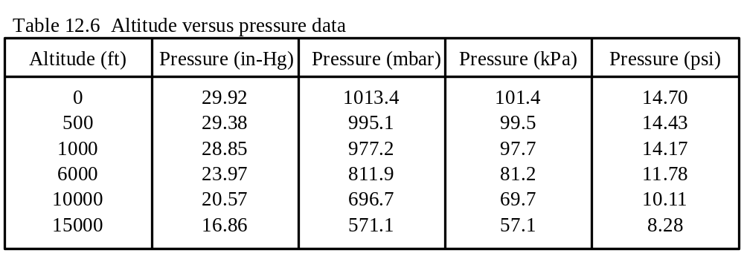
Measuring Barometric Pressure
Barometric pressure is the pressure existing at any point in the earth atmosphere.
The barometric pressure can be measured as an absolute pressure or can be referenced to some other value or scale.
The meteorology and avionics industries measure the absolute pressure.
The units used to represent the barometric pressure include in-Hg, kPa, mbar, and psi.
A comparison of barometric pressures in different units is shown in Table 12.6.
Copyright @ 2005 Delmar Thompson

Slide 72
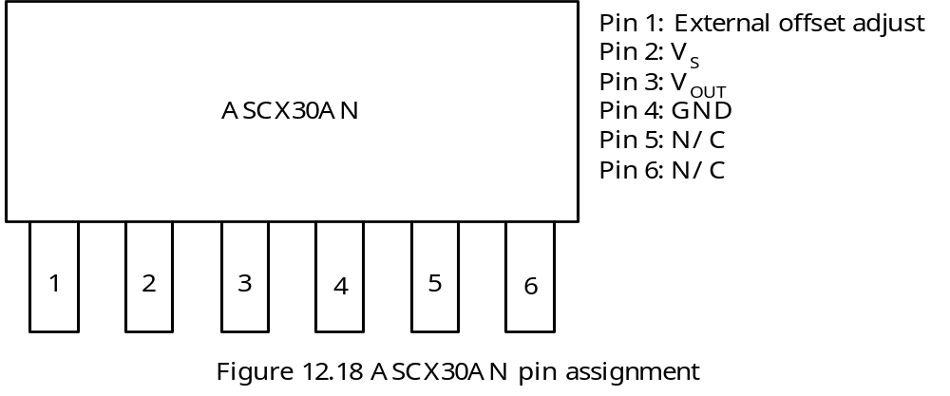
The SenSym ASCX30AN Pressure Sensor
Can measure barometric pressure from 0 to 30 psia
The range of barometric pressure is between 28 to 32 in-Hg or 948 to 1083.8 mbar.
The ASCX30AN output voltage would range from 2.06 V to 2.36 V.
Copyright @ 2005 Delmar Thompson

Slide 73
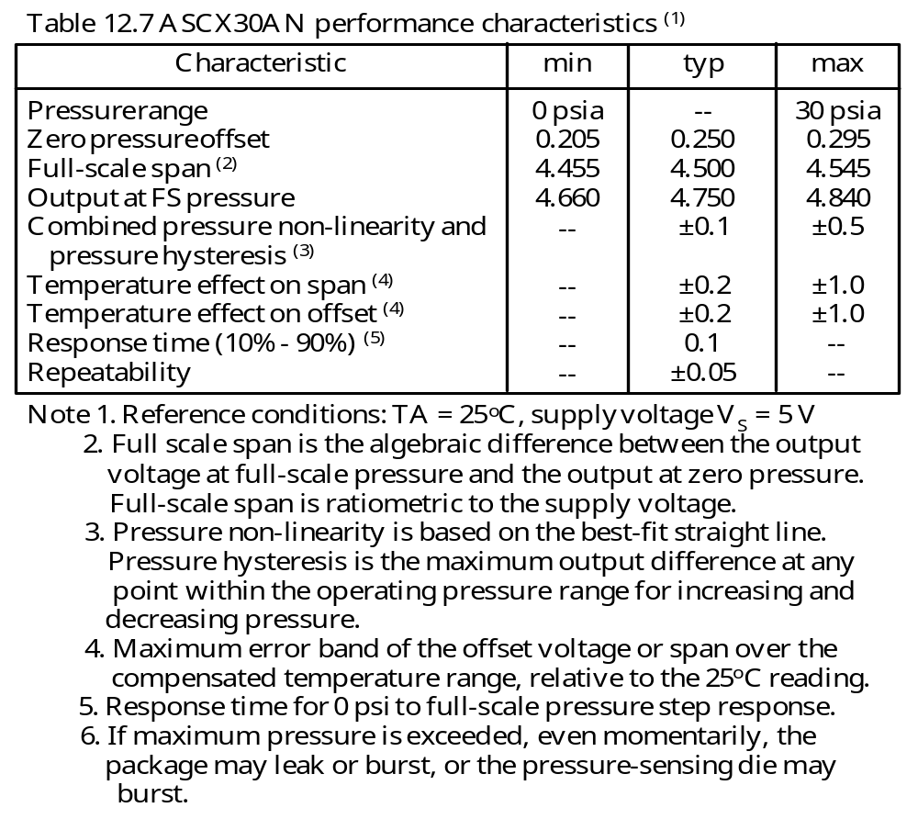
Copyright @ 2005 Delmar Thompson

Slide 74
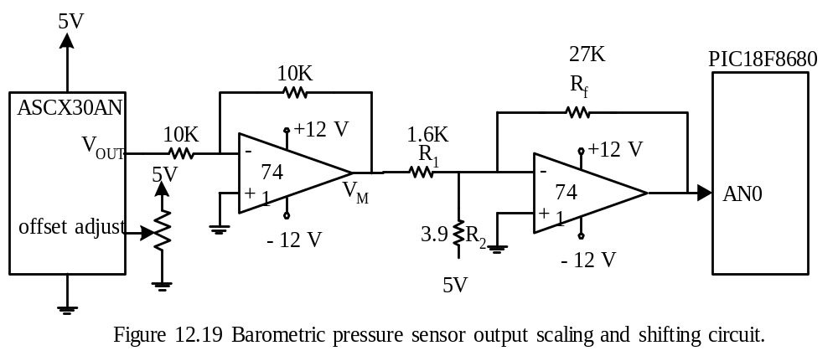
Example 12.10 Describe the circuit connection of the ASCX30AN, the voltage level shifting and scaling circuit, and write a program to measure and display the barometric pressure in units of mbar.
Solution:
A shift and scale circuit is needed to convert the voltage to the range from 0 to 5V.
The typical offset adjust is 0.25V and can be achieved by using a potentiometer.
Copyright @ 2005 Delmar Thompson

Slide 75
The barometric pressure (in mbar) can be derived by dividing the A/D conversion result by 7.53 and then add 948 to the quotient.
Barometric pressure = 948 + A/D result / 7.53
= 948 + (A/D result * 100)/753
#include <p18F8680.h>
#include <timers.h>
#include <adc.h>
unsigned char bp_buf[7];
void main (void)
{
unsigned short long a2d_val;
unsigned short long quo, rem, temp1;
char fd1, i;
ADCON0 = 0x01; //select channel AN0, enable A/D module
ADCON1 = 0x0E; //use VDD, VSS as reference and configure AN0 for analog
ADCON2 = 0xA6; //result right justified, acquisition time = 8 TAD, FOSC/64
OpenTimer0(TIMER_INT_OFF & T0_16BIT & T0_SOURCE_INT &
T0_PS_1_32); //start Timer0 and make it overflow in 200 ms
Copyright @ 2005 Delmar Thompson

Slide 76
while (1) {
bp_buf[0] = 0x20; //set to space
bp_buf[1] = 0x20; //set to space
bp_buf[2] = 0x20; //set to space
bp_buf[3] = 0x30; //set to digit 0
bp_buf[4] = 0x2E; //store the decimal point
bp_buf[5] = 0x30; //set to digit 0
bp_buf[6] = '\0'; //terminate the string with a NULL character
ConvertADC( ); //start an A/D conversion
while(BusyADC()); //wait until A/D conversion is done
a2d_val = 100 * ReadADC();
quo = a2d_val/753; //convert to barometric pressure
rem = a2d_val%753; // "
quo += 948; //add the barometric pressure at A/D
//conversion result 0 to obtain the
//actual barometric pressure
fd1 = (rem * 10)/753; //compute the fractional digit
temp1 = (rem * 10)%753;
if (temp1 > 376) //should we round up the fractional digit?
fd1 ++;
Copyright @ 2005 Delmar Thompson

Slide 77
if (fd1 == 10) { //if fractional digit becomes 10, zero it
fd1 = 0; //and add 1 to integer part
quo++;
}
bp_buf[5] = 0x30 + fd1; //ASCII code of fractional digit
bp_buf[3] = quo % 10 + 0x30; //ASCII code of one's digit
quo = quo / 10;
bp_buf[2] = quo % 10 + 0x30; //ten's digit
quo /= 10;
bp_buf[1] = quo % 10 + 0x30; //hundred's digit
quo /= 10;
bp_buf[0] = quo + 0x30; //thousand's digit
while(!INTCONbits.TMR0IF); //wait until Timer0 overflows
for (i = 0; i < 4; i++) { //wait for Timer0 to overflow four more times
INTCONbits.TMR0IF = 0; //clear the TMR0IF flag
while(!INTCONbits.TMR0IF); //wait for Timer0 to overflow
}
INTCONbits.TMR0IF = 0;
}
}
Copyright @ 2005 Delmar Thompson

